Slide 1
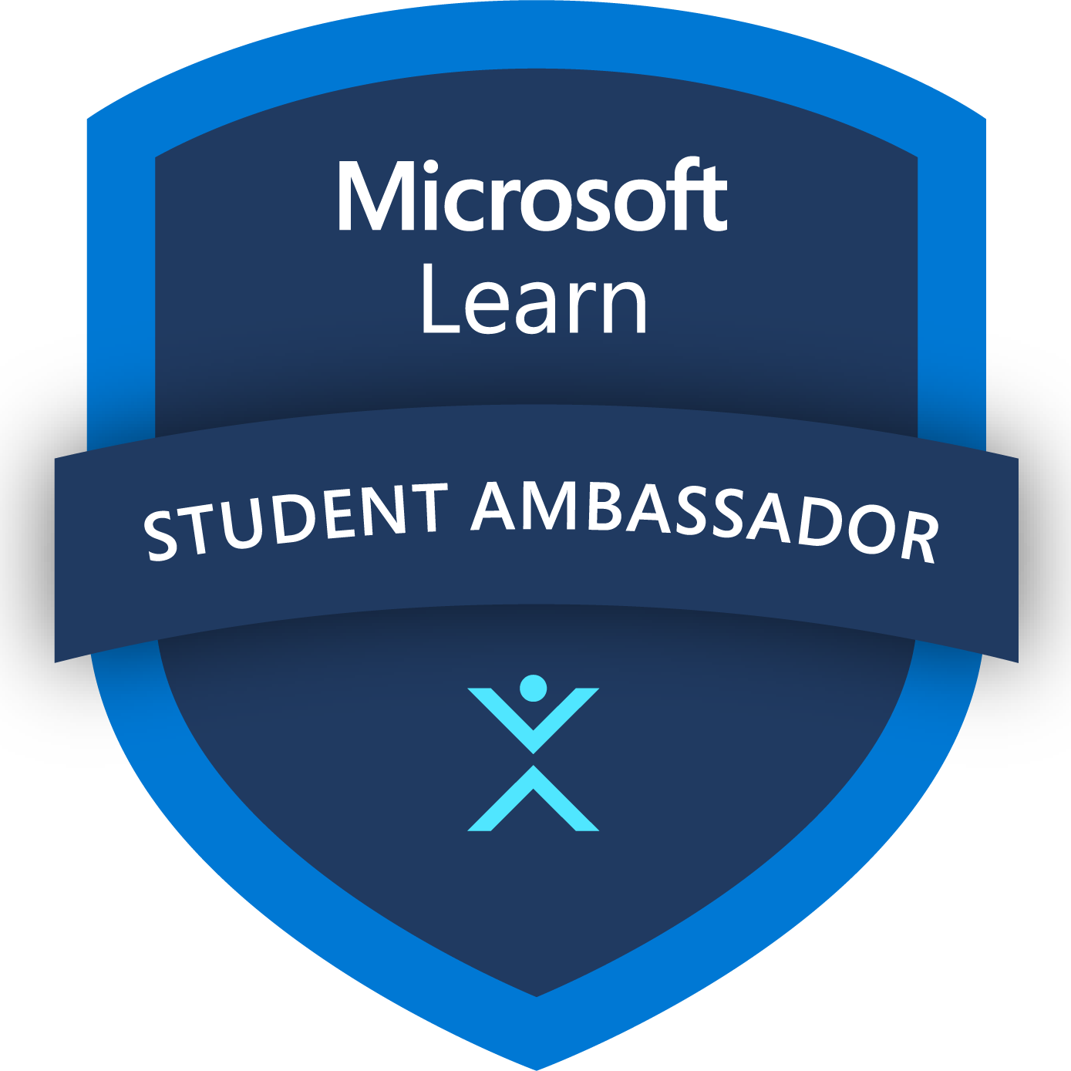
MediCraft Solution Type: Prototype
Mahrukh Khan (Team lead)
Abdul Wahab (Team Co-lead)
Notes:
Korrie

Slide 2
The Opportunity
Direct Response to Literacy Challenges: Our app tackles literacy barriers by providing easy-to-understand wound care instructions in Urdu.
DIY Healthcare Trend: Empowering users to manage wound treatment from their phones.
Agile Startup Innovation: Innovate and deliver an azure backed wound care tool, outpacing larger companies with legacy constraints.
Catalyzing Healthcare Change: We inspire a shift in traditional healthcare practices by integrating smart technology that enhances self-care and accessibility for all.
Notes:
Korrie
updated 7/21

Slide 3
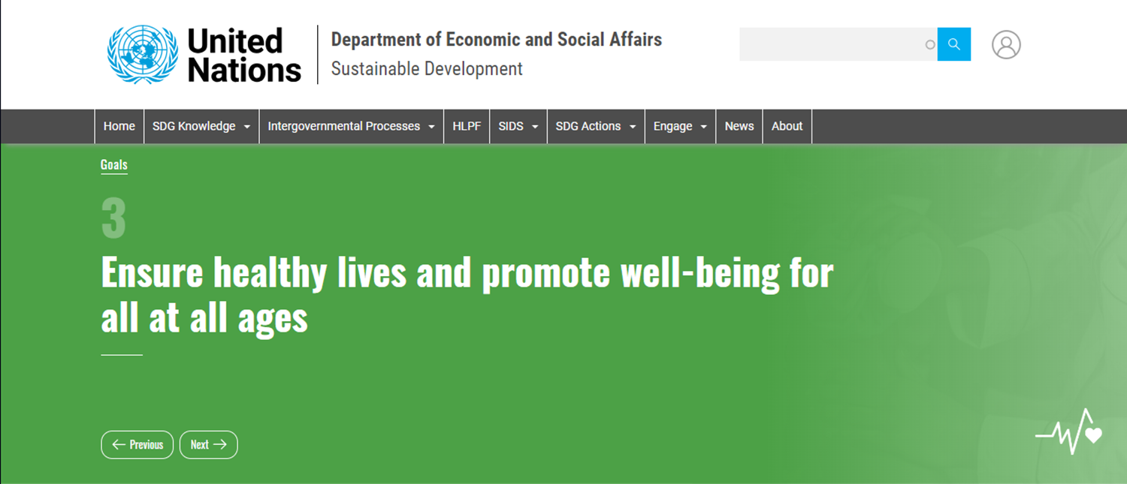

Slide 4
Solution
Instant Health Insights: Our app provides immediate, life-saving information about wounds with a simple tap.
Accurate and Fast Wound Analysis: Leveraging Azure Custom Vision AI, our app analyzes wounds with 85% accuracy with dataset of over 150 images.
Accessibility and Inclusivity:
- real-time image processing, - multi-lingual support including Urdu
- text-to-speech
Notes:
Korrie
updated 7/21

Slide 5
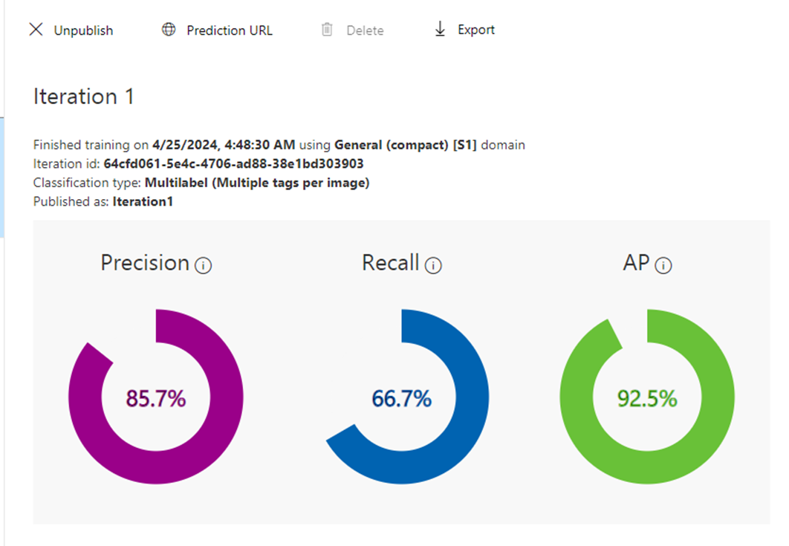
Azure Custom Vision

Slide 6
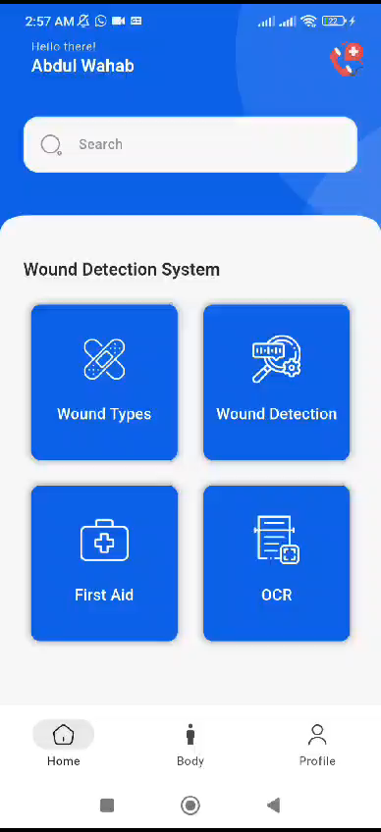
Demo
-Wound Detection Functionality
Notes:
Korrie
updated 7/21

Slide 7
Takeaways
Reassess Wound Care Tools: It's crucial for underdeveloped areas to leverage technology that promotes DIY knowledge.
Embrace AI in Healthcare: AI significantly enhances healthcare on many levels, offering more effective, accessible, and precise medical care.
Forge Strategic Partnerships:
- sets a remarkable benchmark in humanitarian projects.
Highlight Cost Efficiency: Utilizing Azure Custom Vision AI, our application effectively manages large datasets with a single model.
Notes:
Korrie
updated 7/21

Slide 8
Thank you

